Slide 1

Penalty Fever
Saujan Tiwari
Sandeep Acharya
Sangam Chaulagain

Slide 2
Objectives of the project:
To learn and implement the object oriented approach in C++.
To enhance our skills in C++ programming language.
To be familiarized with SFML library for GUI interface.
To learn the basics of game development.
To learn to work in a group as team.

Slide 3
About Penalty Fever
A simple football penalty game created as a part of our C++ project
Easy to understand and play the game
Built using the standard rules of the penalty in football
Can play in single player as well as double player mode

Slide 4
Penalty Fever is built by using
Compiler: GNU GCC Compiler
IDE: Code::Blocks
GUI Library: SFML-2.5.1

Slide 5
Gameplay
Gameplay is exactly similar to the penalty shootout in football.
Two teams play penalty shootout where the shooter is from one team and the goalkeeper from the opposite team.
The roles of the shooter and goalkeeper is reversed once the shoot is taken.

Slide 6
Gameplay
Similar reversal of role takes place until both teams shoots 5 shots each.
The team with higher goals after 5 shots is declared as the winner.
In case the score is draw after 5 shots, the game enters into the Sudden Death Mode.
In Sudden Death Mode, if one team scores and other fails to score the goal, team scoring the goal is declared as the winer.

Slide 7
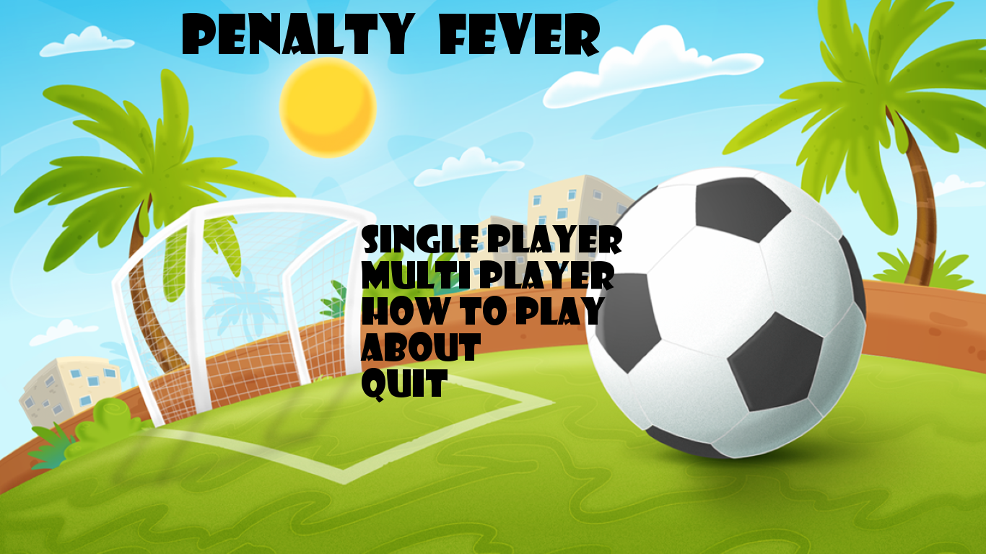

Slide 8
ABOUT

Slide 9
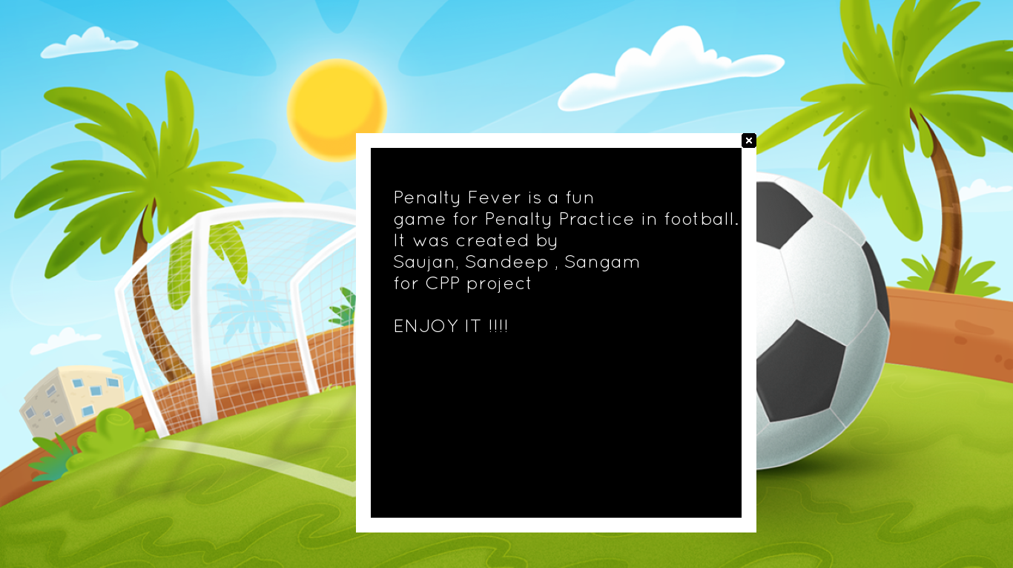

Slide 10
HOW TO PLAY

Slide 11
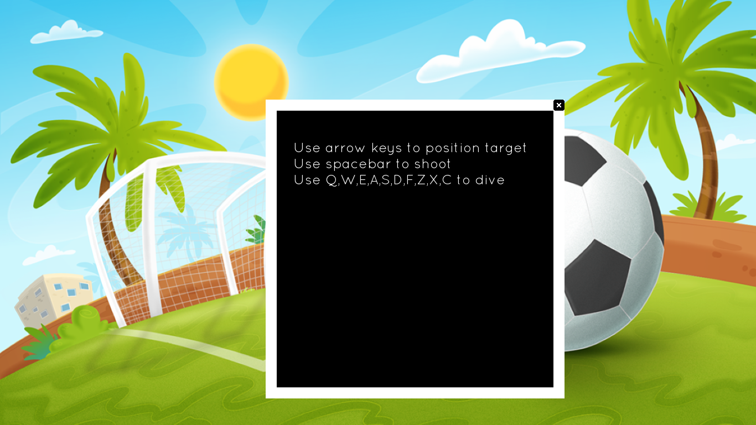

Slide 12
How to Play
Player can position the target using the arrow Keys
Up, Down, Left and Right arrow keys are pressed in order to position the target in the place where the player want to shoot.
After positioning the target, the player can shoot the ball in that position by pressing Space button.

Slide 13
Controlling the goalkeeper
Q W E
A S D
Z X C
Q- Dive in the Left Top Corner
E- Dive in the Right Top Corner
Z- Dive in the bottom Left Corner
C- Dive in the bottom Right Corner
and so on.

Slide 14
Modes of Game
Single Player Mode
Multiplayer Mode

Slide 15
Single Player Mode
In this mode of the game, Player can shoot the ball first. At the same time, CPU will fulfill the role of the goalkeeper.
After the first shot, the role is reversed. i.e. CPU will shoot the ball and the player have to control the goalkeeper.

Slide 16
Multiplayer Mode
In this mode of the game, two players can play at the same time using different parts of the keyboard.
After each shot, the role of the players are exchanged. If Player2 shooted the ball first and Player2 became goalkeeper, Player1 becomes goalkeeper and Player2 shoots the ball in next shot.

Slide 17
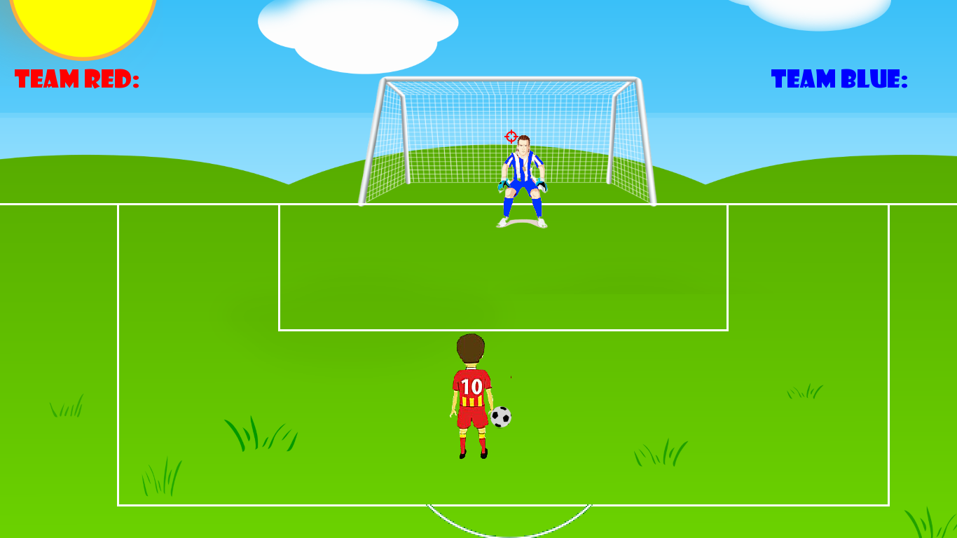

Slide 18


Slide 19
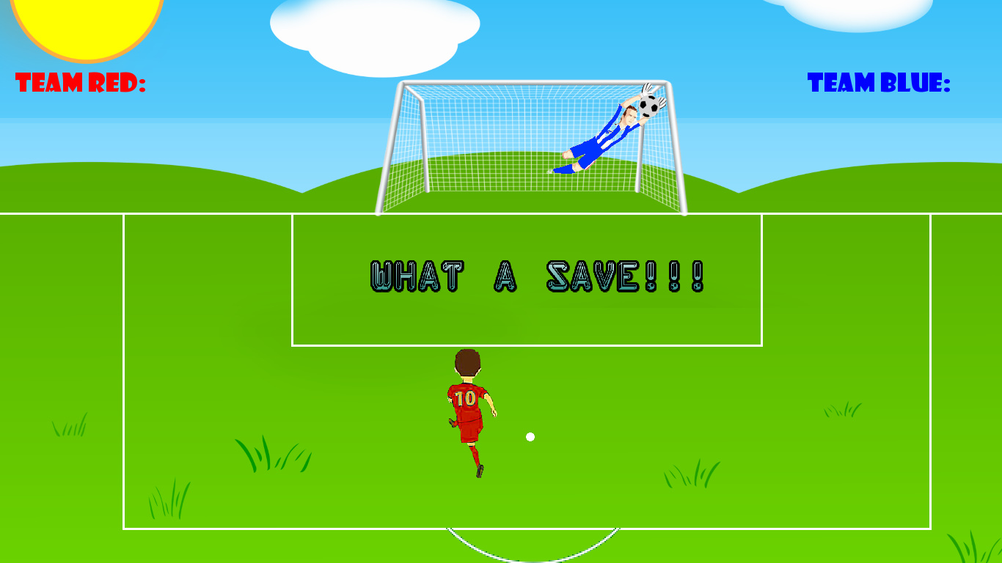

Slide 20
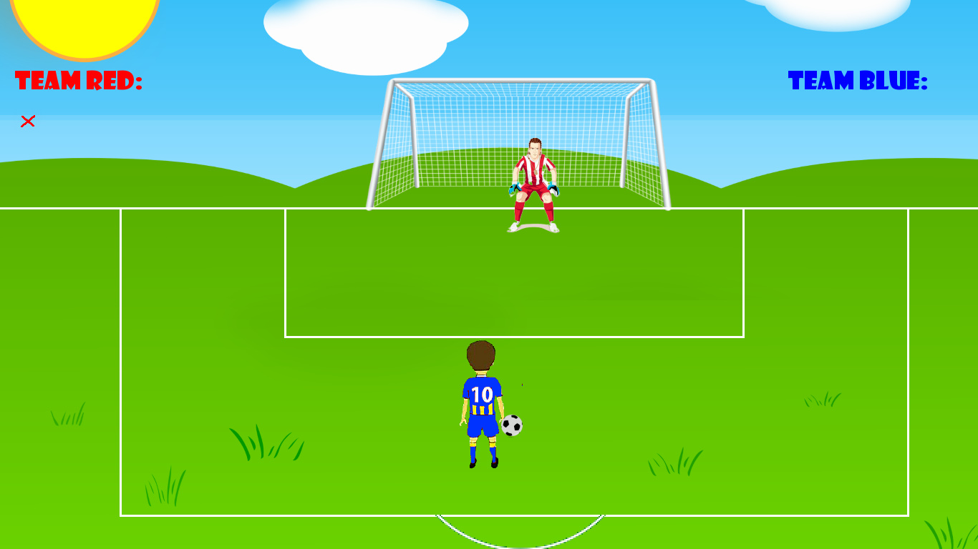

Slide 21
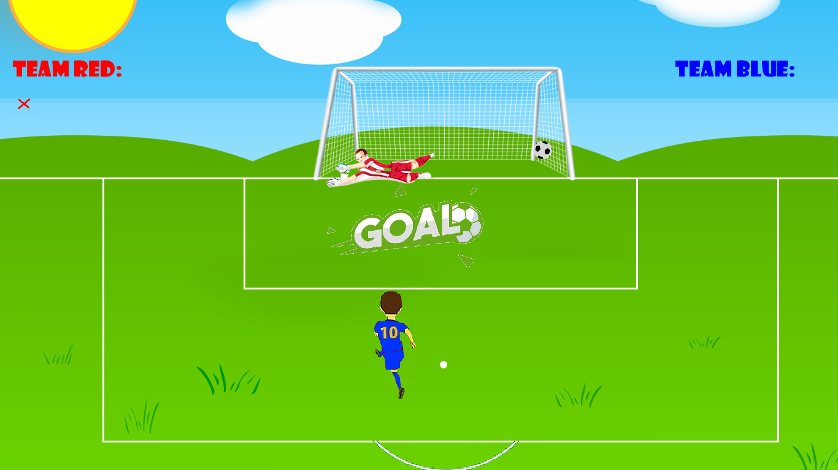

Slide 22
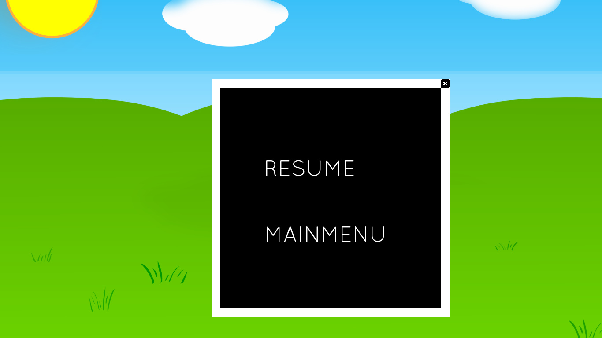

Slide 23
Scoring
Football Mark is used to count the goal.
Cross Mark is used to count the miss.

Slide 24


Slide 25
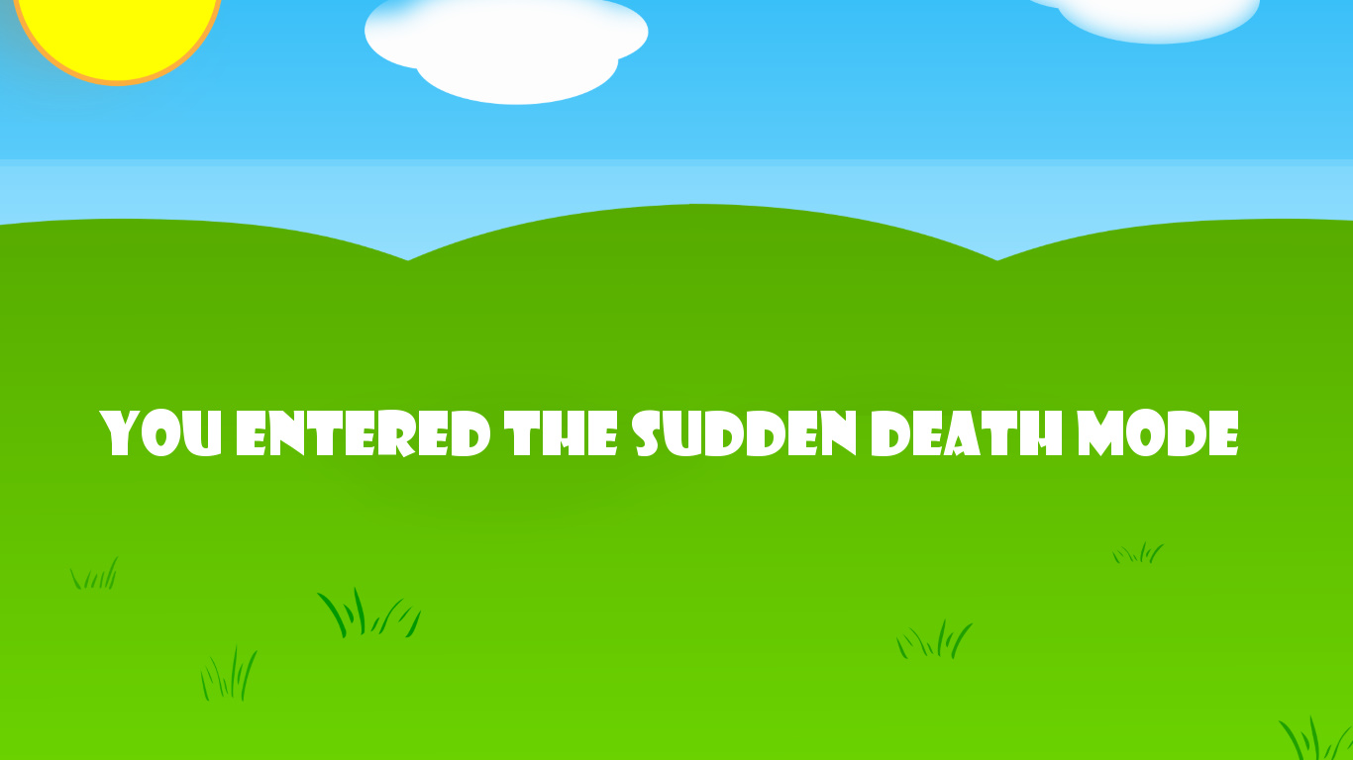

Slide 26
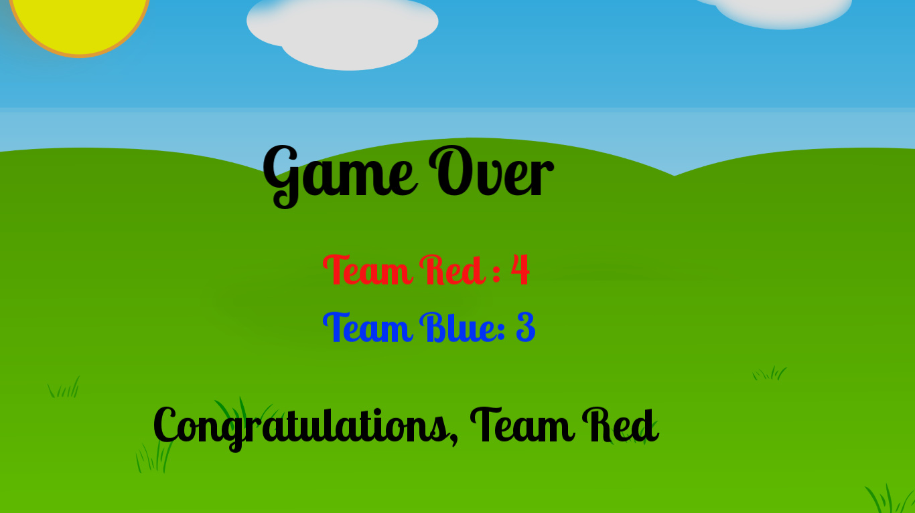

Slide 27
Flow of the game

Slide 28
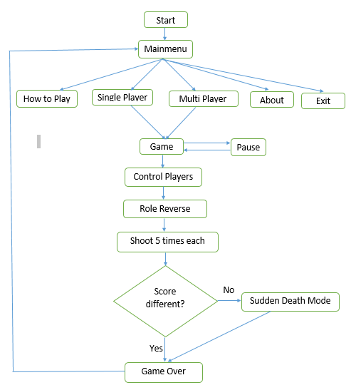
Flow of the game

Slide 29
Header Files
Collision.h
Football.h
Game.h
Goalkeeper.h
Goalpost.h
Mainmenu.h
Shooter.h
Target.h

Slide 30
Class Game
Game()
run()
processEvents()
update()
render()
resetScore()

Slide 31
Class Mainmenu
Mainmenu()
sf::Sprite getsprite()
sf::Text gettext()
bool checker()
void setcolor()
void resetcolor()
void setpos(float,float)
voidsetstring(std::string)

Slide 32
Class Football
Football()
sf::Sprite getSprite()
bool kick(sf::Vector2f,sf::Vector2f &newpos)
void spawn()
sf::Vector2f getPosition()
void playSound()
void draw(sf::RenderWindow &window)

Slide 33
Class Target
Target()
void handle_input()
void moveTarget()
void spawn()
void setSpritePosition(int,int)
sf::Vector2f getPosition()
void update(sf::Time)
void checkPosition()

Slide 34
Class Shooter
Shooter()
sf::Sprite getSprite()
void spawn()
void kick()
void setToBlue()
void setToRed()
sf::Vector2f shootPosition()

Slide 35
Class Goalkeeper
Goalkeeper()
bool handle_input()
void kick(int,float)
void spawn()
sf::Vector2f getPosition()
int divePosition()
void setToBlue()
void setToRed()
void update()
void resetPosition()

Slide 36
Class Goalpost
Goalpost()
sf::sprite getSprite()
void draw(sf::RenderWindow &window)

Slide 37
Limitations
Only two teams (Red and Blue) can be choosen.
No mode to select different playgrounds.
Ball can’t be shooted outside the goalpost.
There are some positions in goalpost where goal is always scored.
Difficult to play multiplayer mode due to invisible target position.

Slide 38
Future Enhancement
This game can be enhanced with various teams and different playing locations.
Different tournaments and league modes can be added in the game.
It can be made more advanced with the use of different viewing modes(game camera),and realistic graphics.
Realistic Player Engine(advanced AI in both goalkeeper and kick taker) can be made.

Slide 39
Conclusion
Better understanding of the OOP and its implementation was done in this project.
Successful implementation of a practical program was done working together as a team.
We became familiar with the SFML Library for the GUI Interface in C++.
Basics of the game development was learned and implemented properly.

Slide 40
Thank You Any Queries?

